Slide 1
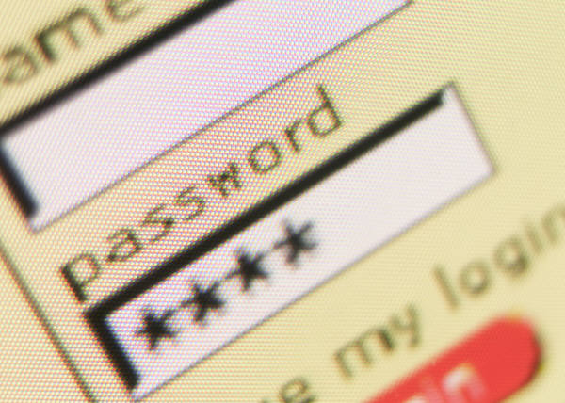

Your Passwords,
Change them.
Presented by

Slide 2
Top ten most common passwords of 2013
123456
password
12345678
qwerty
abc123
123456789
111111
1234567
123123
Admin
Hackers are not babies.
They know how you think.

Slide 3
How passwords are attacked
Dictionary attacks
Social engineering
Brute force

Slide 4
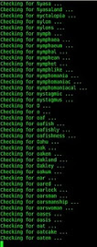
Dictionary attacks
- The guessing of a password by repeated trial and error.
Criminals use programs that automatically try passwords from a dictionary file containing millions of common passwords and word combinations in all different languages.
Some attacks can also try variations of the included words
Reversed (e.g., “terces”)
Mixed case (e.g., SeCreT)
Character/Symbol replacement (e.g., “$ecret”)
Words with vowels removed (e.g., “scrt”)
Up to the attacker’s imagination…

Slide 5
Social engineering
- The art of manipulating people so they give up confidential information.
Others can hear you give a password to someone you trust.
Someone looking over your shoulder can discover a password.
Don’t keep a copy of your passwords where other can find it.
Fake tech support can call you asking for your password.
Technological phishing (more on this in a later presentation).

Slide 6
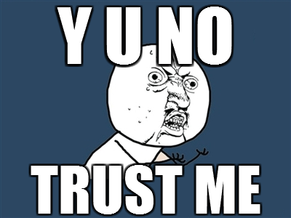
In short:
DON’T TRUST ANYONE!

Slide 7
Brute force attacks
- Guessing every possible permutation of a password until it is found.
Short, weak passwords can be cracked in under an hour by a single computer.
Long, strong passwords can take every computer on earth working together a thousand years to crack.
The time it takes is based on the password’s “entropy”.

Slide 8
Entropy
For a password, "entropy" is related to "guessability". Low entropy is easier to guess, high entropy is harder to guess.
The primary aspect is randomness. A non-random password, like "secret", is easily guessed. A random password, like "8jh$#F" is harder to guess.
Length plays a part, too. "secret of a lifetime man" is not much more random than "secret", but the additional length means it is harder for a brute-force attack to crack, and therefore it has better "entropy".
So, to a layman: A good password has high entropy, which means it is hard to guess, uses multiple character types (upper-lower-number-symbol), and the longer the better.

Slide 9
The four character types
English uppercase letters (A, B, C).
English lowercase letters (a, b, c).
Arabic numerals (1, 2, 3).
Special characters ( !, *, $, or other punctuation symbols).
Each additional character type you include in your password exponentially increases brute force attack times.

Slide 10
Overview: Weak passwords
based on common dictionary words
based on common names
based on user/account identifier
short (under 6 characters)
based on keyboard patterns (e.g., “qwerty”)
composed of a single character type (e.g., all lowercase characters)
resemble license plate values

Slide 11
Overview: strong passwords
Examples:
L*6v11E5Lgr
aC&3i7$l*5
Y7#RQ^e#f
890NEs2%a
T3CH&R3pU8Lic
Multiple character types
Long
Random

Slide 12
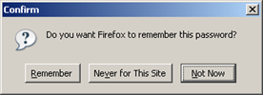
Password managers
Don’t use the same password for sites/services.
Every year major sites are breached by criminals.
Once a site is hacked your password can be used elsewhere.
Having multiple strong passwords can be impossible to remember.
BUT…
Never store your passwords with your browser – malware can easily access it!

Slide 13
Password managers
Instead, use an ENCRYPTED password manager.
Common Features:
Store unique passwords for every site/service
Remember a single strong password to access all others
Automatically enters passwords into login screens
Informs you of password strength
Cross platform (shares passwords across windows, ios, android, etc)

Slide 14
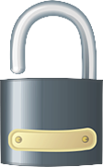
Summary
Create strong passwords
Keep them a secret
Don’t trust anyone
Don’t reuse passwords
Use an encrypted password manager

